Slide 1
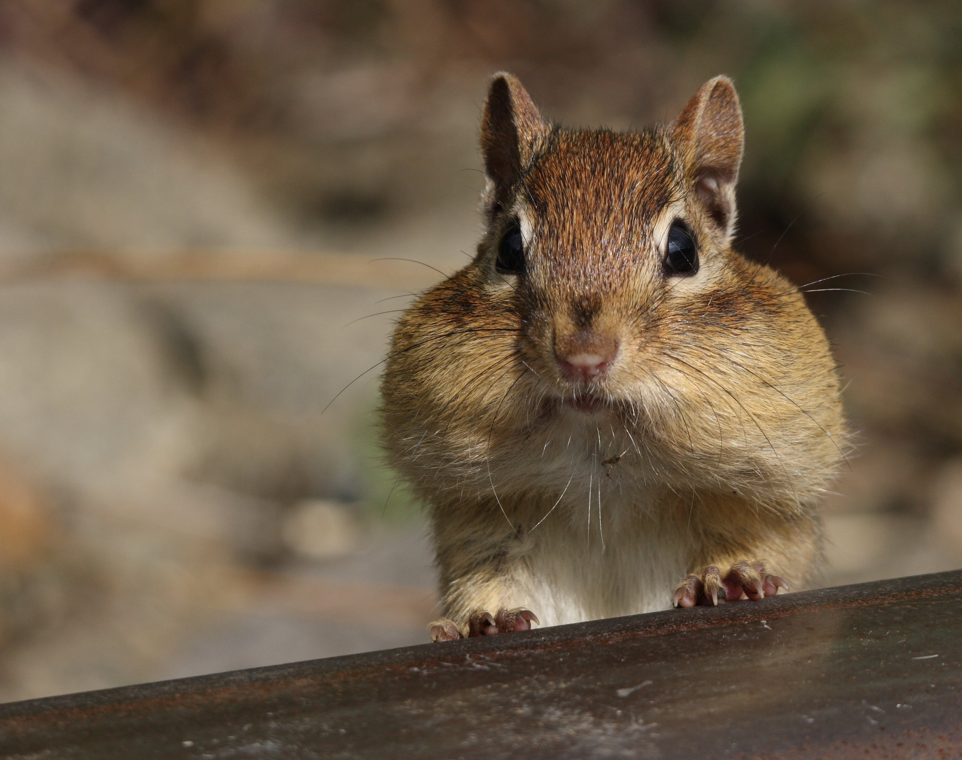
Chipmunk
Barbora Čechová

Slide 2
They are small.

Slide 3
They aren´t dangerous.

Slide 4
They are friendly.

Slide 5
Chipmunk lives in Canada.

Slide 6
They are beautiful and thin.

Slide 7
They are funny.

