Slide 1
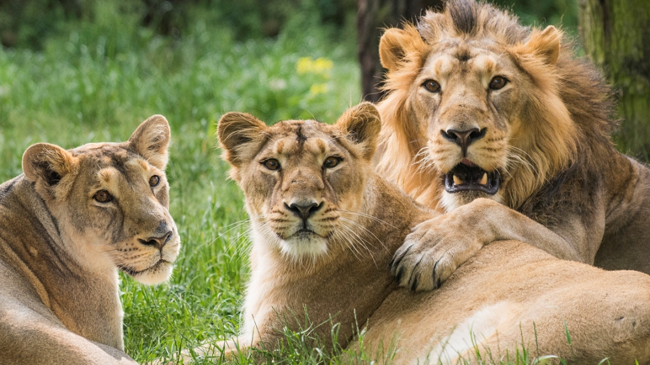
LIONS

Slide 2
LIONS ARE VERY DANGEROUS

Slide 3
LIONS ARE STRONG AND BEATIFUL

Slide 4
THEY AREN´T FRIENDLY AND SMALL

Slide 5
THEY LIVE IN AFRICA

