Slide 1
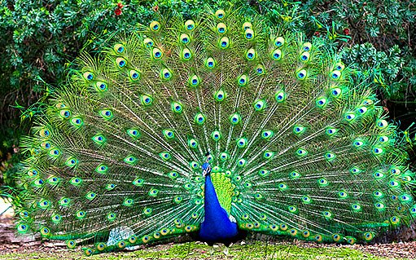
PEACOCKS

Slide 2
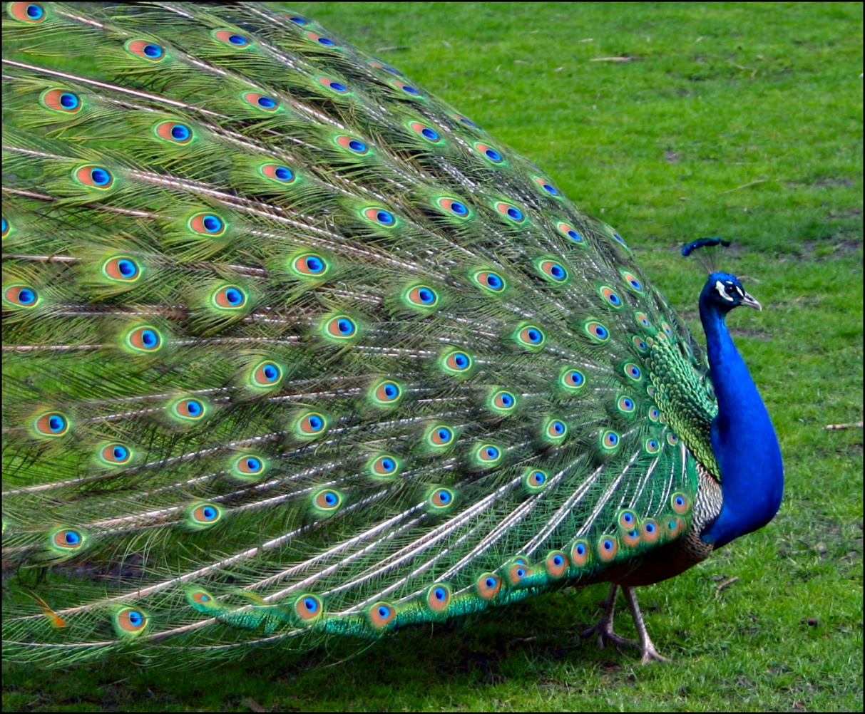
PEACOCKS ARE VERY BEAUTIFUL.

Slide 3
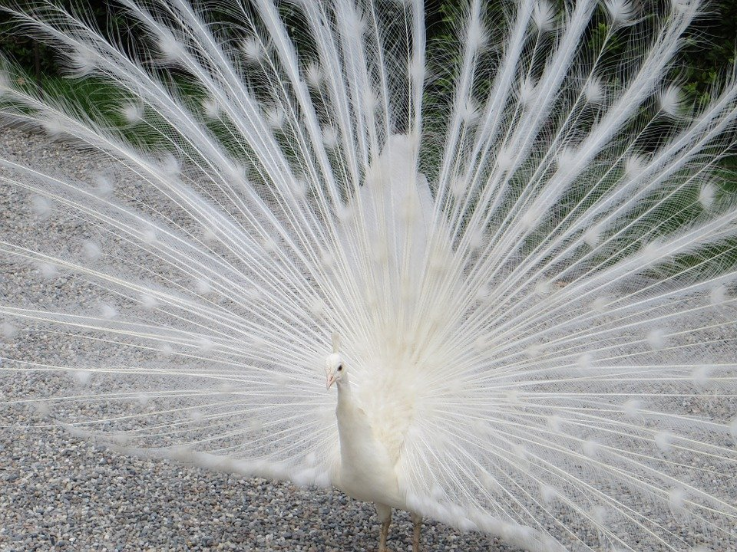
THEY ARE SMALL AND COLORED.

Slide 4
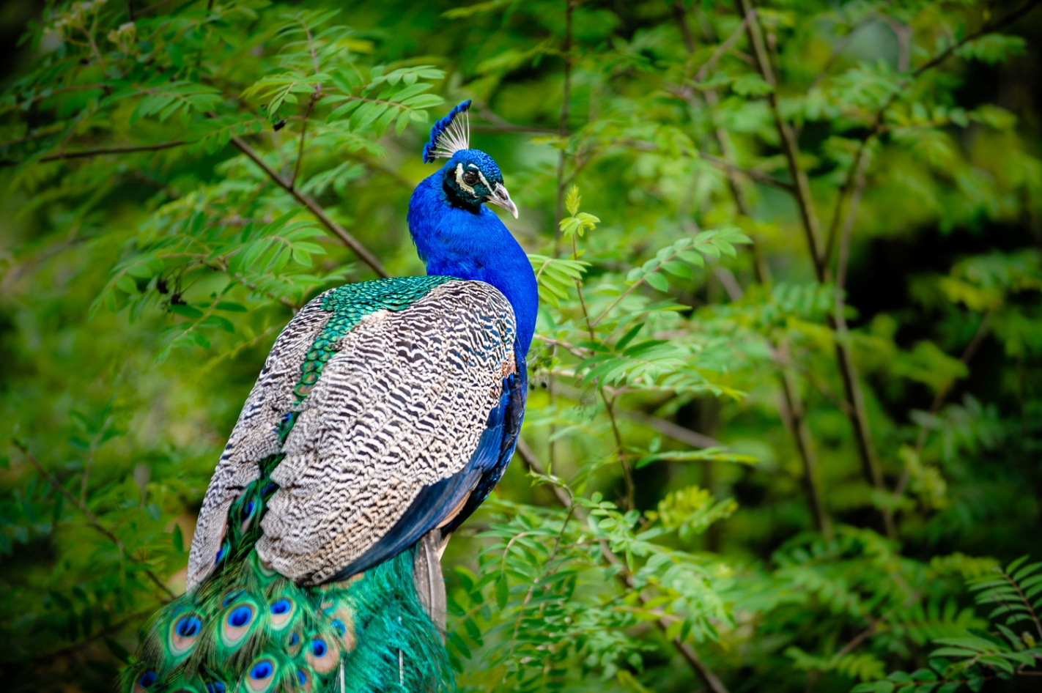
THEY AREN´T BIG AND STRONG.

Slide 5
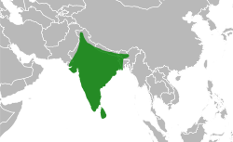
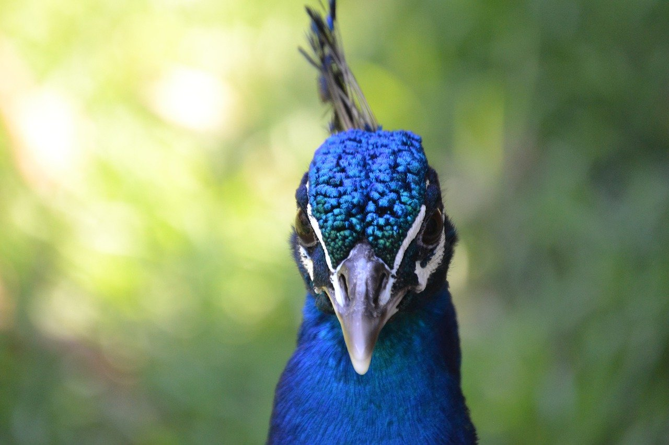
THEY LIVE IN INDIA.

Slide 6
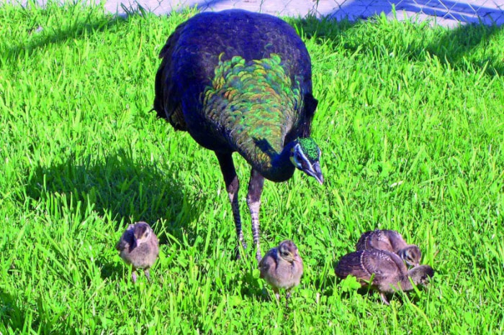
THEY EAT PLANTS AND ANIMALS.

