Slide 1
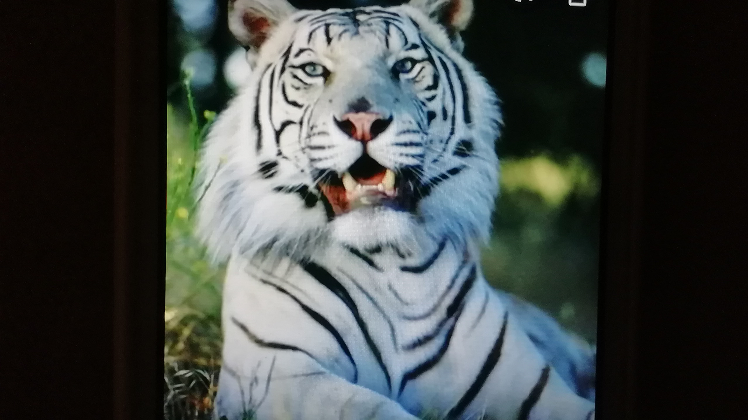
White tiger
Jolča Balhárková

Slide 2
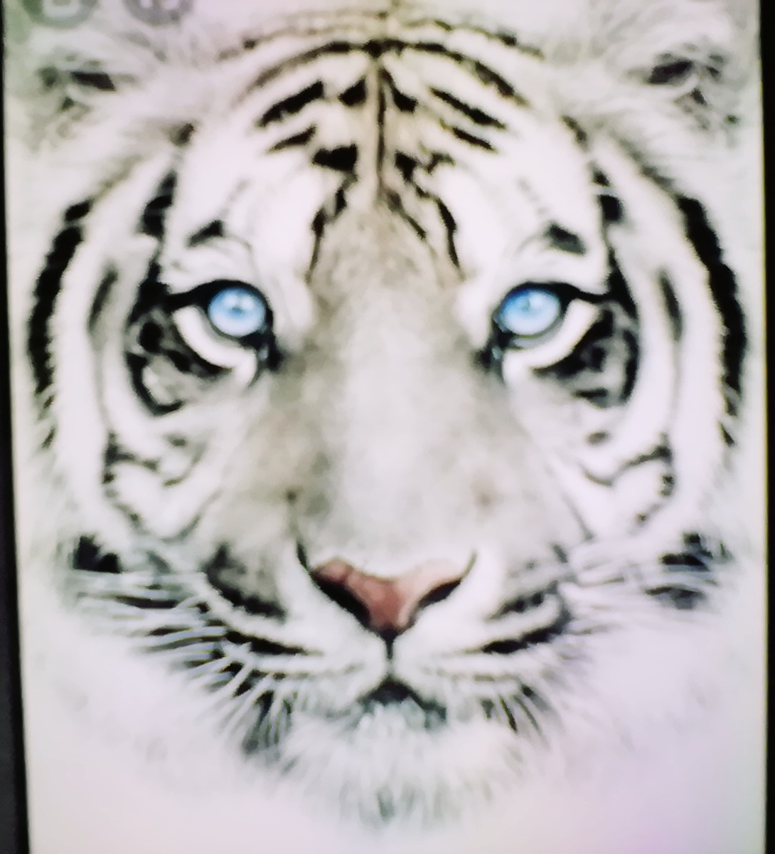
Tigers are dangerours 🐯
Tyger IS not home animal
Tiger lives in Zoo, in Africa and in Asia.

Slide 3
White tigers
runs pretty Fast
eats meat
is strong and beautiful 💖💪

Slide 4
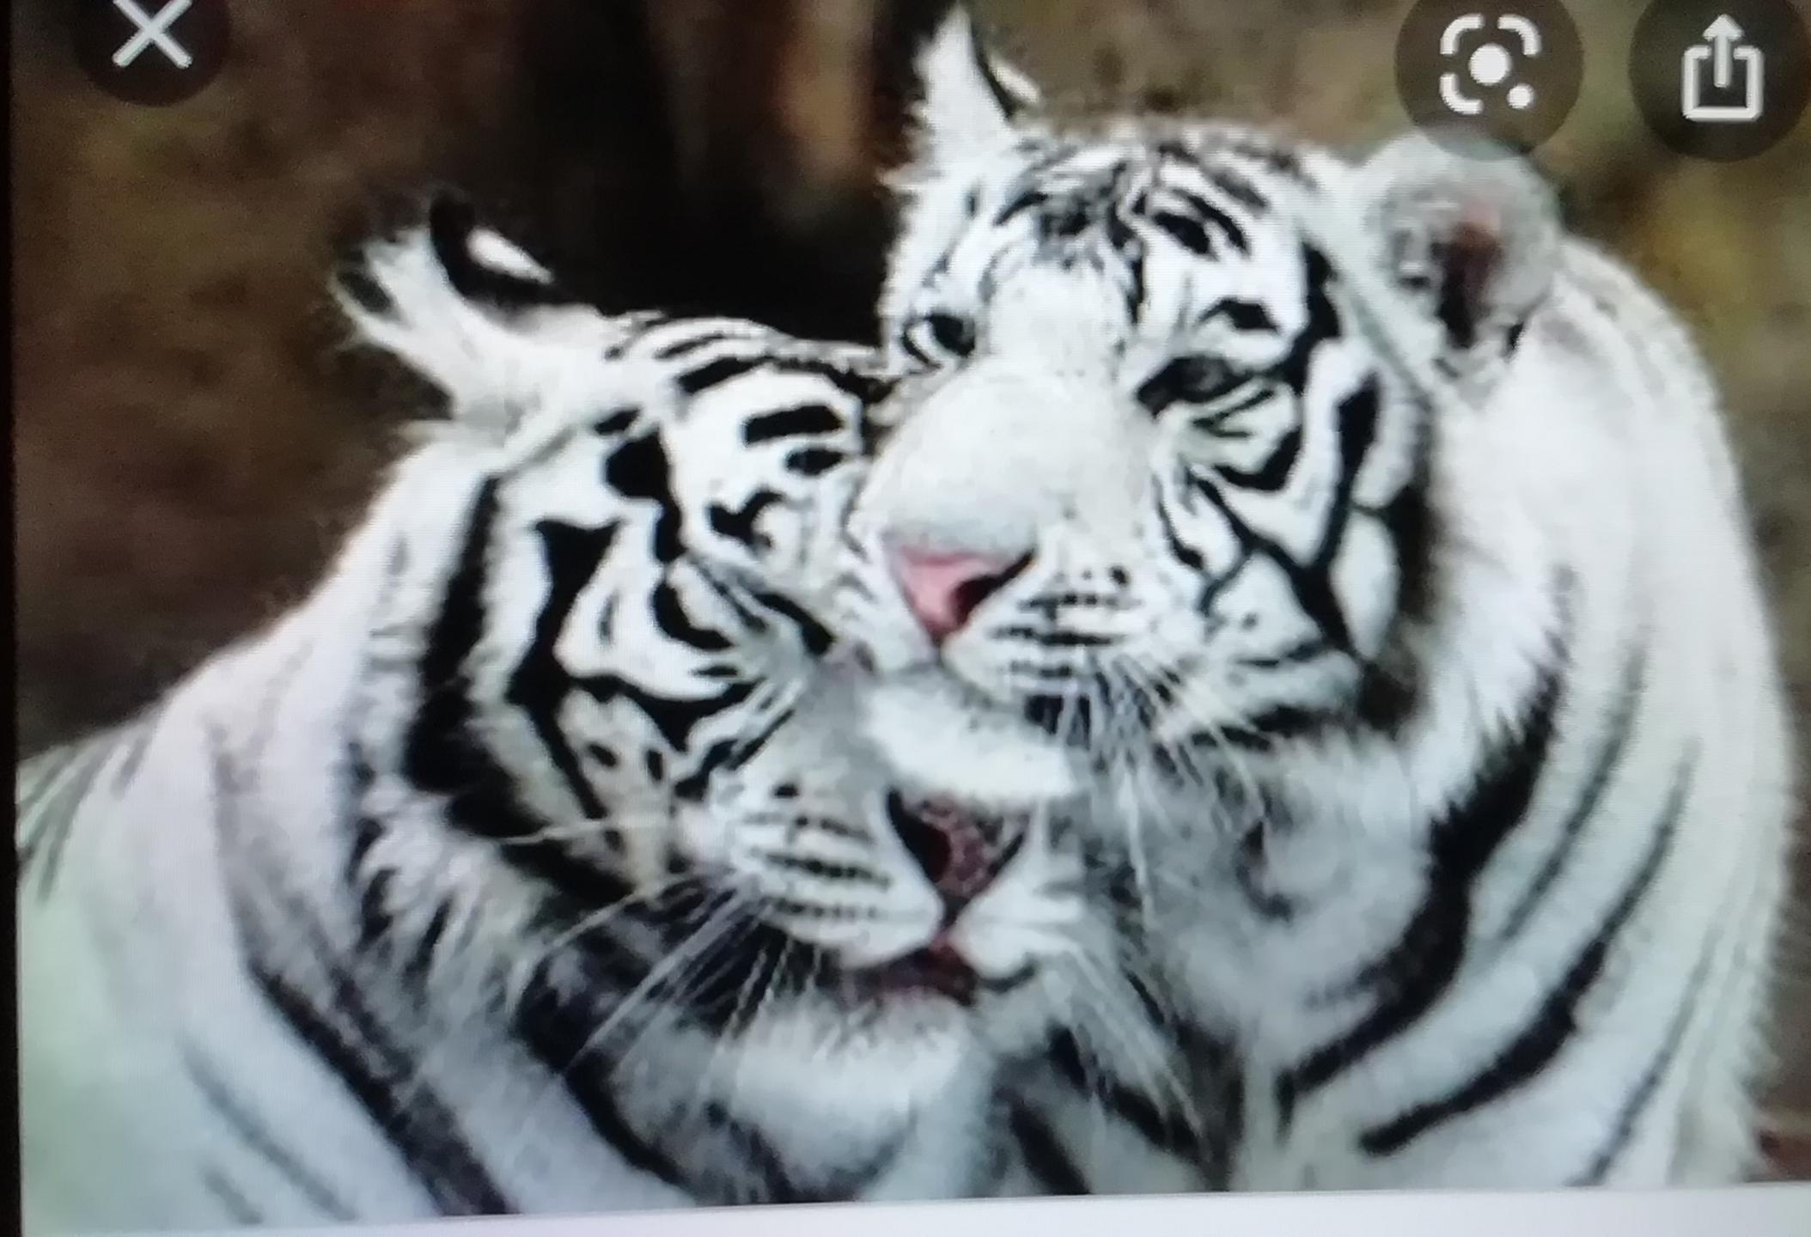
Can White tigers swim?
Yes Tigers can swim
They enjoy swimming

Slide 5
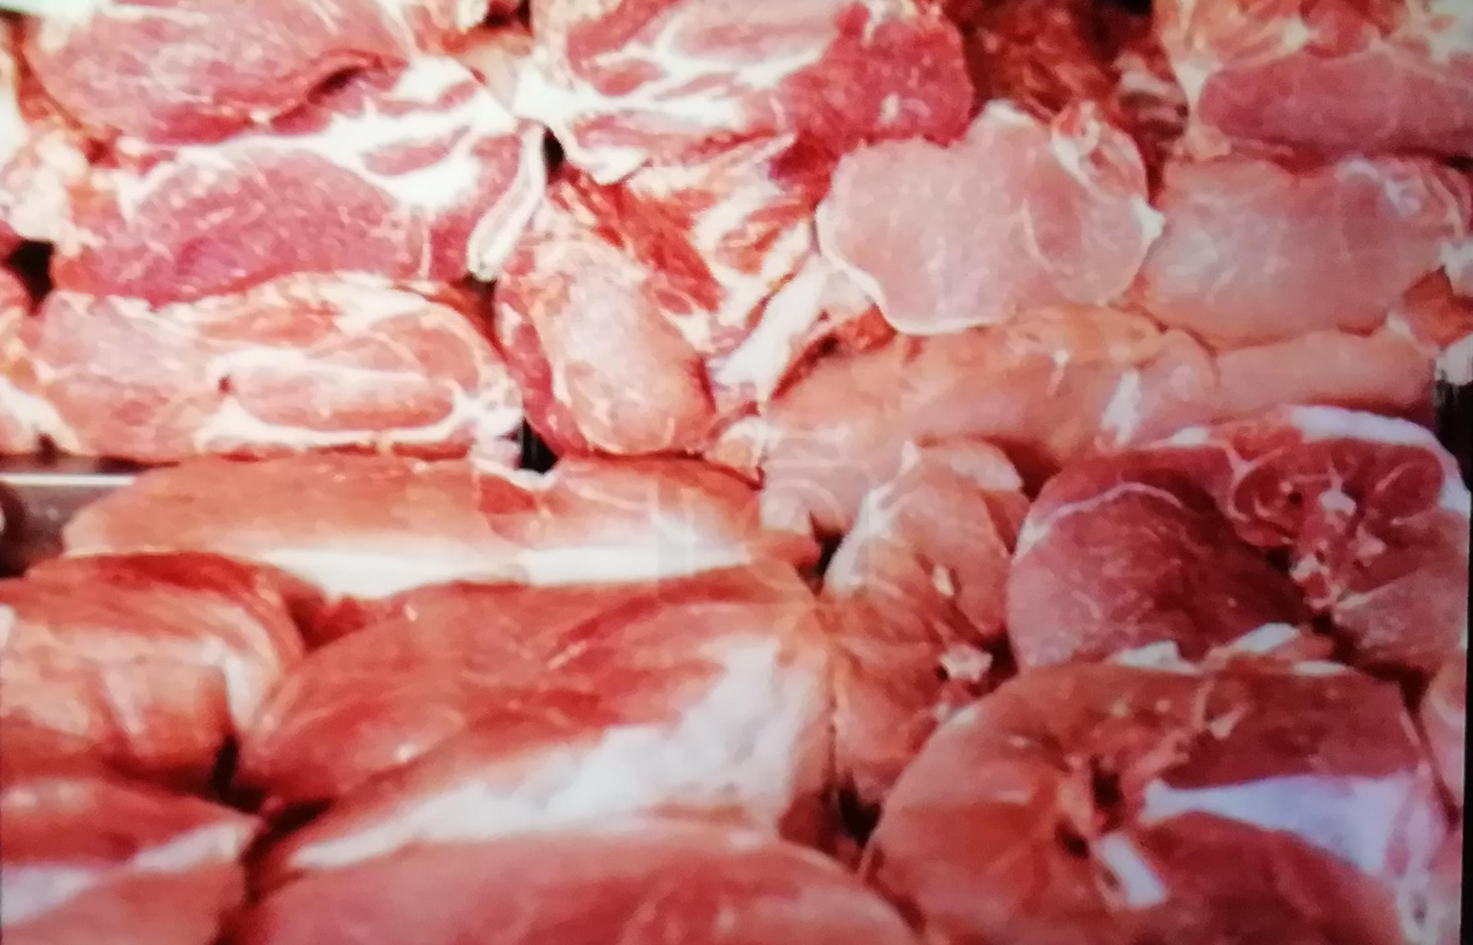
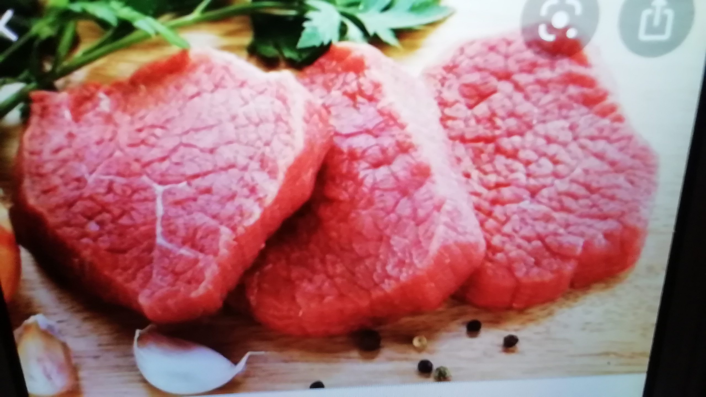
His favorite meal is every meat🙂

Slide 6
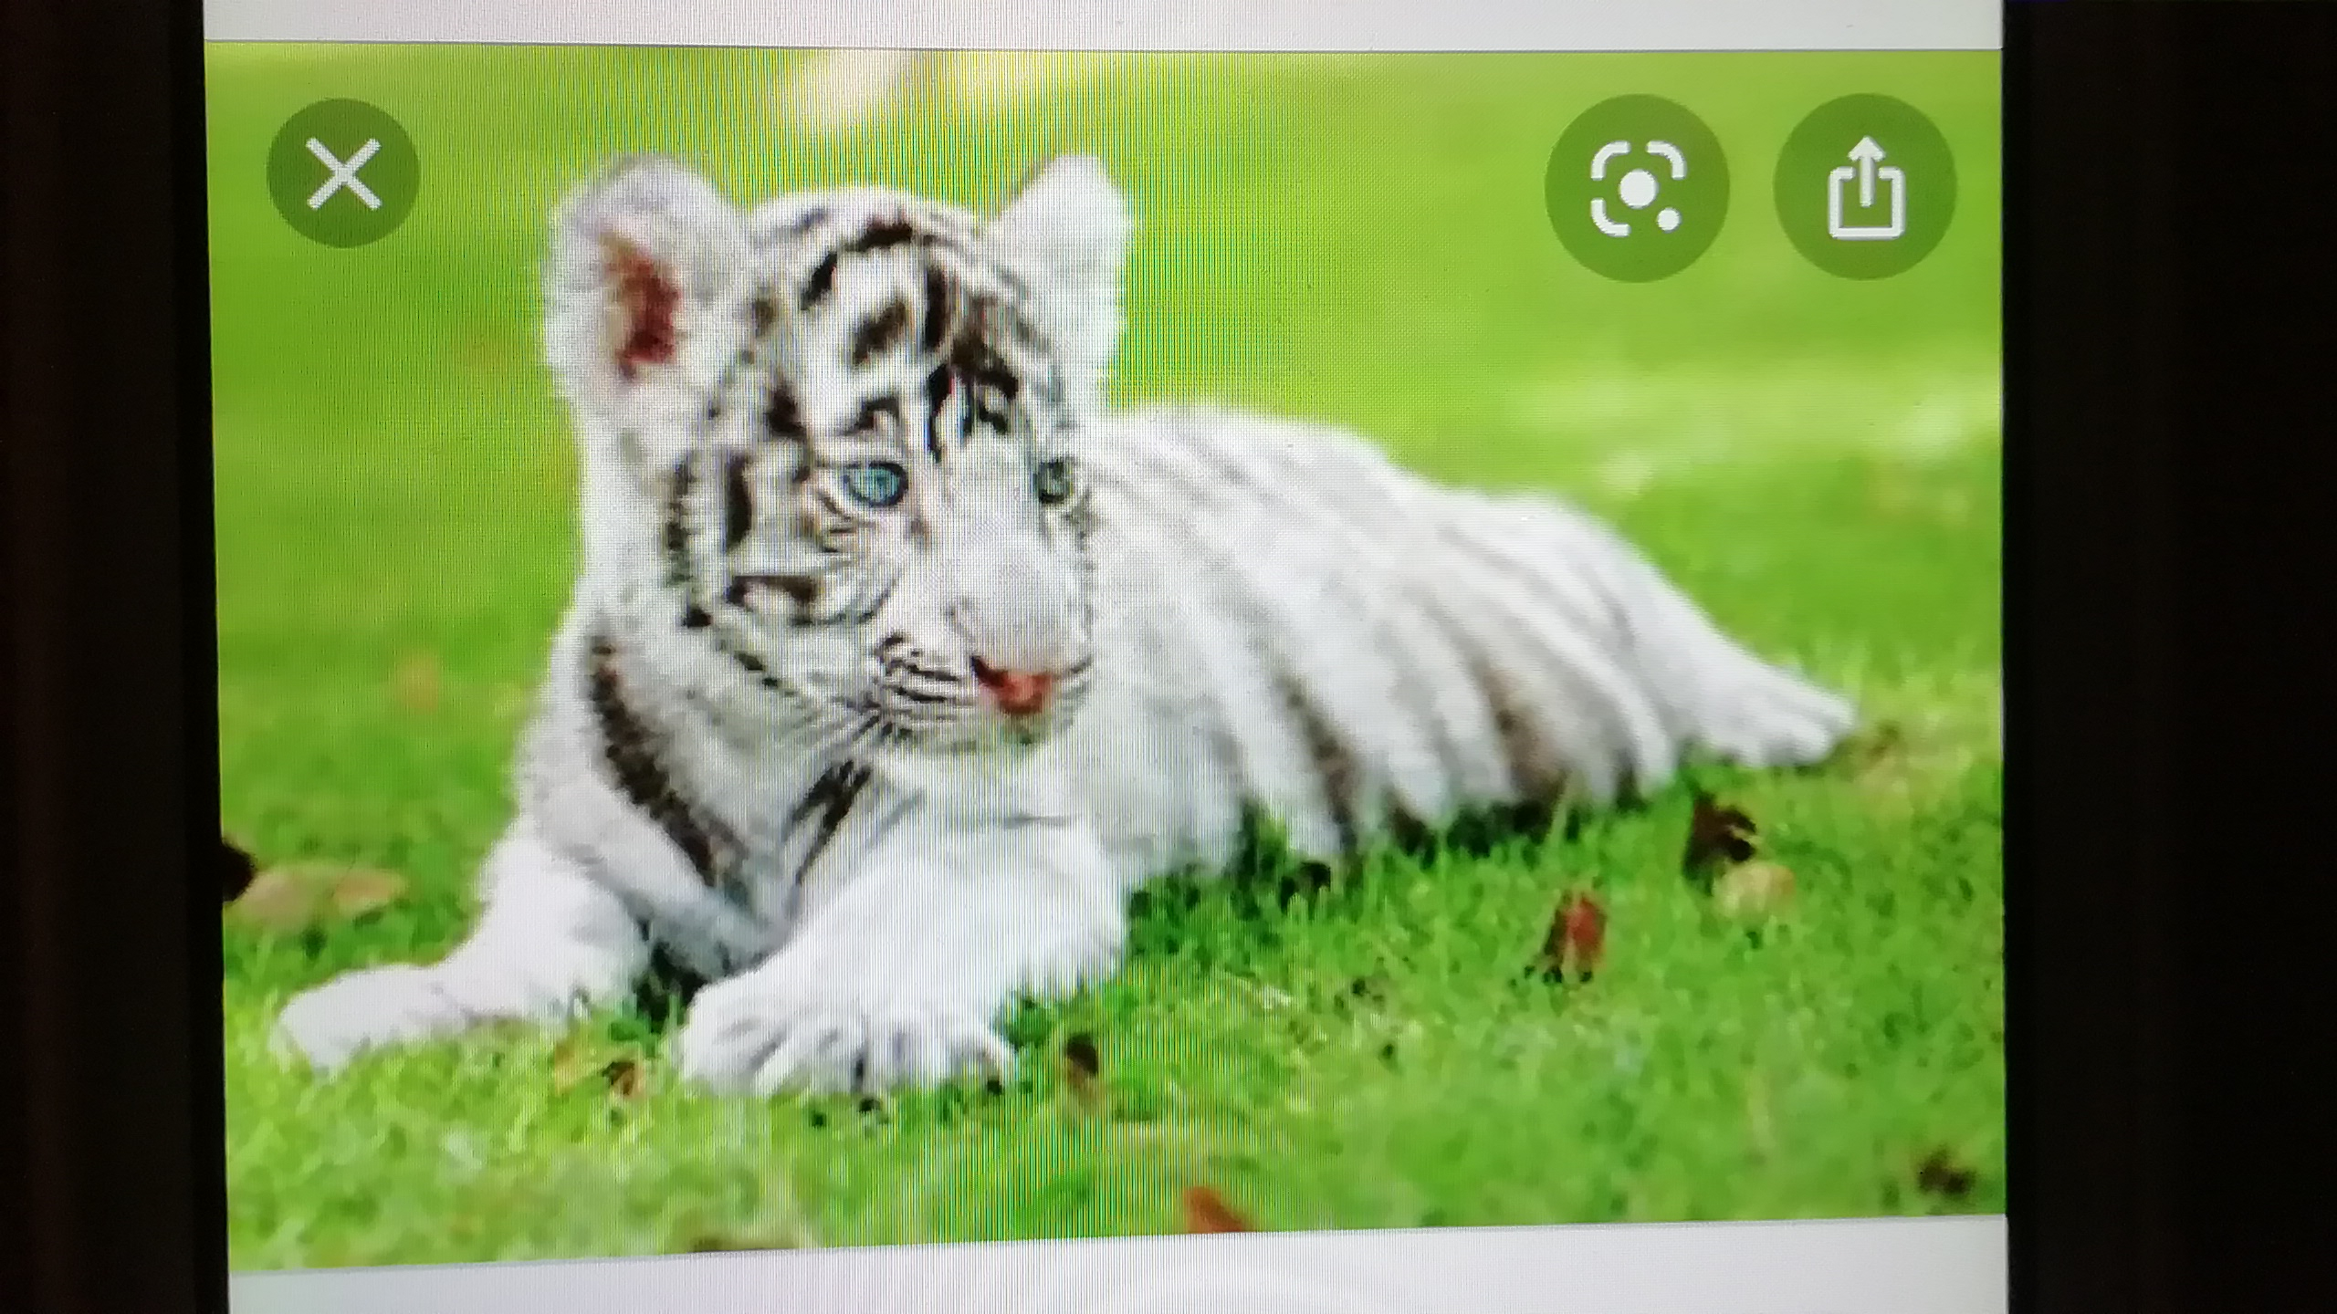
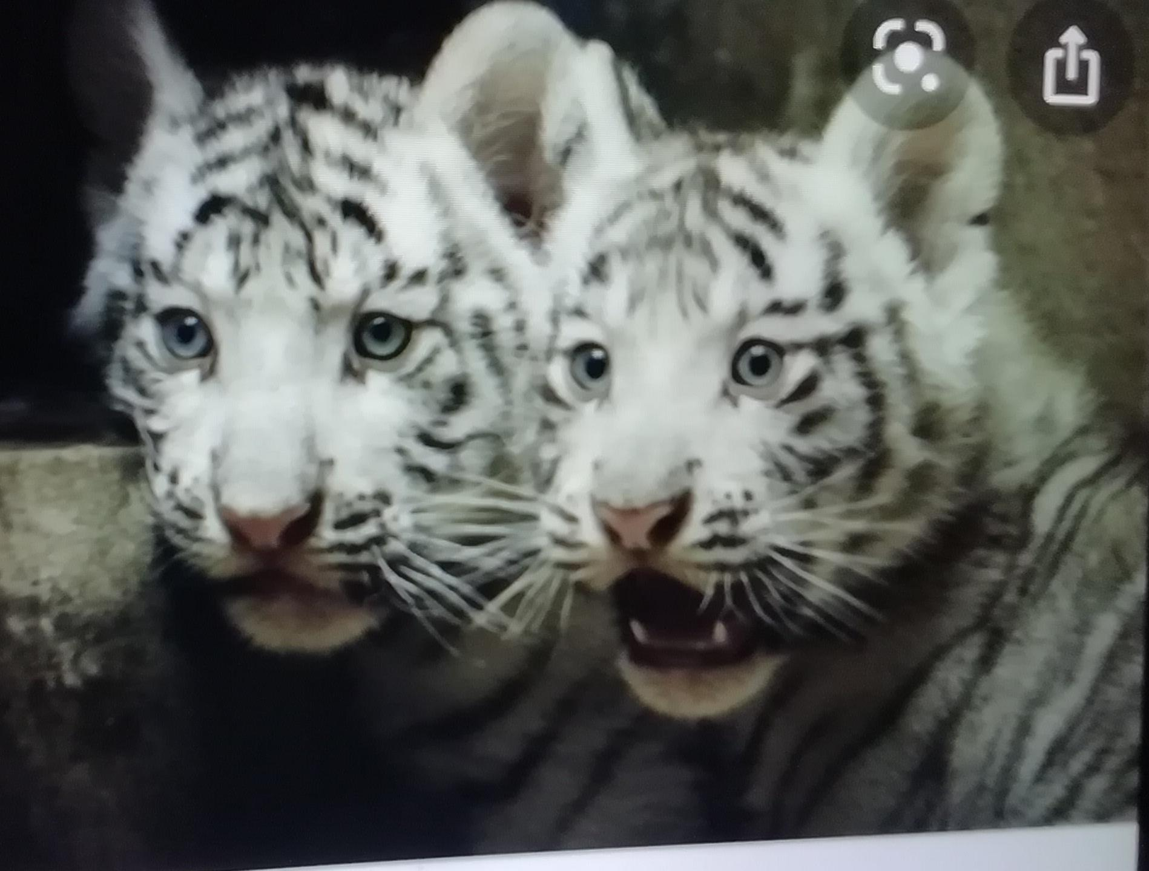
His baby IS so much cute!!!!🤩
I love Tiger👍
Cože!

